Slide 1
Meeting Minutes Generating System
Amal Babu
Roll No : 1
MCA S6

Slide 2

Intro
Important meetings take place in your office every day. These meetings' decisions can cost a lot of time and money, and they can even change people's careers. With so much at risk in meetings, it's no surprise that meeting minutes are highly valued. Meeting minutes serve as a record of what was discussed and resolved at the meeting, as well as what actions must be taken, by whom, and when.

Slide 3
Basic needs in meeting Minutes
01. Date, time and location of the meeting.
02. The purpose of the meeting.
03. Names of attendees and those who were unable to attend.
04. Agenda items.
05. Decisions that were made.
06. Actions that need to be done. Include the deadline and who it was assigned to.
07. Follow up meeting

Slide 4

Drawbacks in Organizing & set up Meeting
Notify About meeting
Tracking past Reports
Maintain attendance
Manual recording of the group’s process and decisions
Build up final conclusion from speech
Manually Generating meeting minutes
Voting system
1
2
3
4
5
6
7

Slide 5
Proposed Model
Provides separate accounts for meeting organizer
and other members in the meeting
Admin or organizer generates next meeting details and notify other members through mail or SMS.
3. Members of this system can see past events, meeting minutes, Agenda and conclusions.
4. From speech recognition this system automatically generates conclusion about that section.
5. From using conclusions and the details in the system it generates meeting minutes
6. We can also keep attendance in the system.
7. Remainder about next meeting.

Slide 6

Related literature
TEXT SUMMARIZATION - Steps
Preprocessing the texts
Word frequency
Weighted word frequency
Sentence tokenization
Score for the sentences
Order the sentences
Generate the summary

Slide 7
Related literature
1. PREPROCESSING THE TEXTS
Artificial intelligence is human like intelligence. It is the study of
intelligent artificial agents. Science and engineering to produce
intelligent machines. Solve problems and have intelligence. Related to
intelligent behavior. Developing of reasoning machines. Learn from
mistakes and successes. Artificial intelligence is related to reasoning in
everyday situations
artificial intelligence human like intelligence. study intelligent artificial
agents. science engineering produce intelligent machines. solve
problems intelligence. related intelligent behavior. developing
reasoning machines. learn mistakes successes. artificial intelligence
related reasoning everyday situations

Slide 8
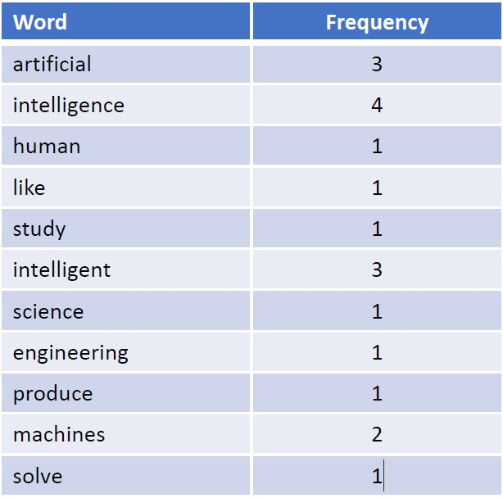
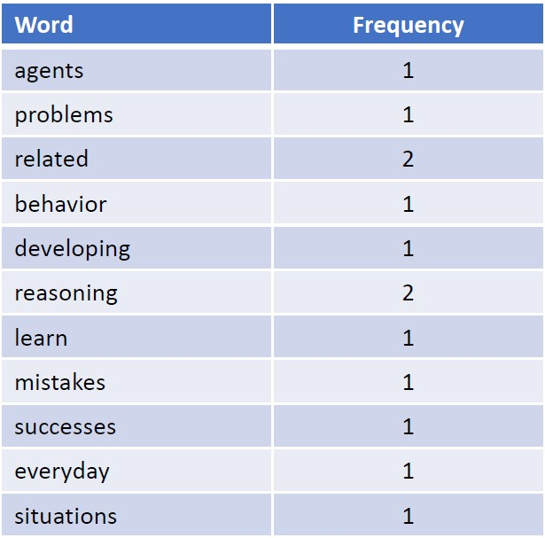
Related literature
2. WORD FREQUENCY

Slide 9
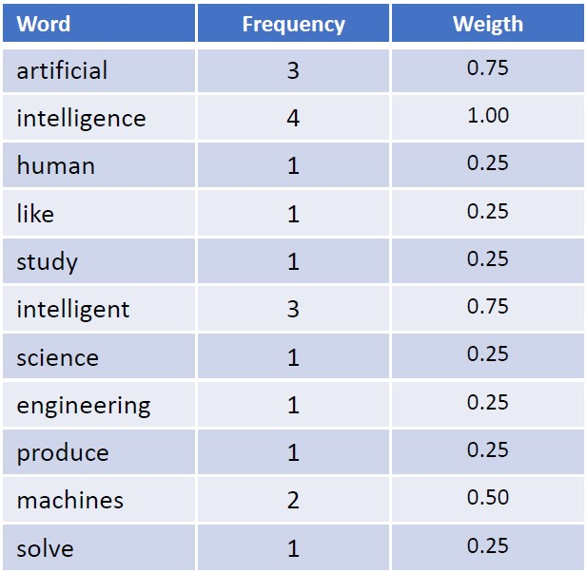
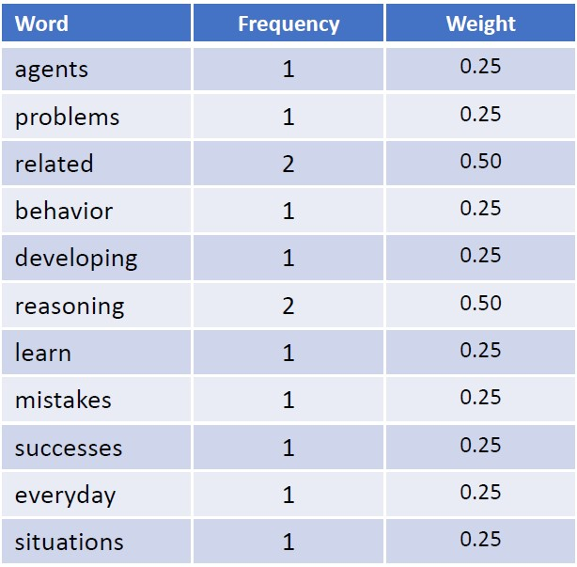
Related literature
3. WEIGHTED WORD FREQUENCY
Highest value: 4

Slide 10
Related literature
4. SENTENCE TOKENIZATION
Artificial intelligence is human like intelligence. It is the study of intelligent
artificial agents. Science and engineering to produce intelligent machines.
Solve problems and have intelligence. Related to intelligent behavior.
Developing of reasoning machines. Learn from mistakes and successes.
Artificial intelligence is related to reasoning in everyday situations
Tokenization
Artificial intelligence is human like intelligence.
It is the study of intelligent artificial agents.
Science and engineering to produce intelligent machines.
Solve problems and have intelligence.
Related to intelligent behavior.
Developing of reasoning machines.
Learn from mistakes and successes.
Artificial intelligence is related to reasoning in everyday situations

Slide 11
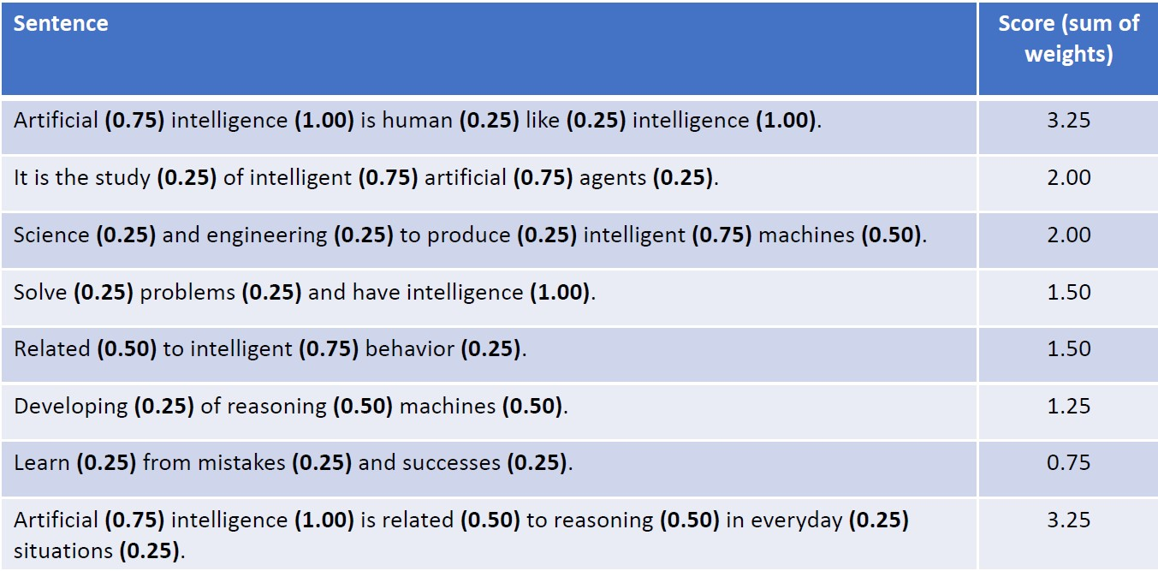
Related literature
5. SCORE FOR THE SENTENCES

Slide 12
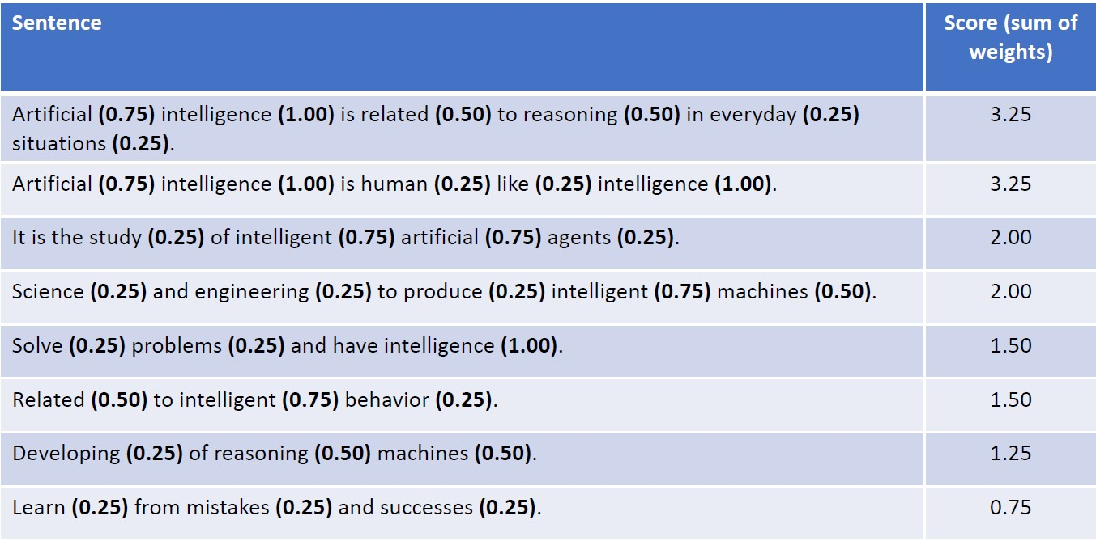
Related literature
6. ORDER THE SENTENCES

Slide 13
Related literature
7. GENERATE THE SUMMARY
Artificial intelligence is human like intelligence. It is the study of
intelligent artificial agents. Science and engineering to produce
intelligent machines. Solve problems and have intelligence. Related to
intelligent behavior. Developing of reasoning machines. Learn from
mistakes and successes. Artificial intelligence is related to reasoning in
everyday situations
Artificial intelligence is related to reasoning in everyday situations. Artificial
intelligence is human like intelligence. It is the study of intelligent artificial agents.

Slide 14
Related literature
Cosine similarity
Cosine similarity is a measure of similarity between two non-zero vectors of an inner product space that measures the cosine of the angle between them. Since we will be representing our sentences as the bunch of vectors, we can use it to find the similarity among sentences. Its measures cosine of the angle between vectors. Angle will be 0 if sentences are similar.
Input Text → split into sentences → remove stop words → build a similarity matrix → generate rank based on matrix → pick top N sentences for summary.

Slide 15
Related literature
LUHN ALGORITHM
Luhn’s algorithm is an approach based on TF-IDF.
Select most important words based on frequency
Determines which words are more significant towards the meaning of document.
find out the most common words in the document, and then take a subset of those that are not these most common english words, but are still important.
It begins with transforming the content of sentences into a mathematical expression, or vector. Then we count all the valuable words left to us.
In this step we use evaluate sentences using sentence scoring technique.
Score= (Number of meaningful words)²/(Span of meaningful words)
Once the sentence scoring is complete, the last step is simply to select those sentences with the highest overall rankings.

Slide 16
Architecture of Cosine similarity based system
Input Text
Split
Sentences
Encode
Vectors
Cosine Similarity
Summary
Sentence Ranking
pagerank
Graph
Similarity Matrix

Slide 17
Generalized Diagram -Text summarizing
Raw Text
1
Removing Stop Words
2
Stemming
3
Special Character Removal
4
Sentence
Segmentation
5
6
Tokenization
7
8
9
10
11
12
Feature Extraction
Weight Computation Feature vector
Get most Salient Sentences
Compute similarity and Rank sentences
Generate Summaary
Summary Evaluation

Slide 18
DFD Admin side
Admin
Request for Login
Login
Check for login
Response
Reply
Add/delete
Login member
Update Data
Response
Reply
Add attendance
Attendance
Insert Data
Response
Reply
Speech to text + Text summarizer
Add Minutes
Track meeting minutes
Update minuts
Response
Reply
Scheduling new Meeting
Add Event
Track upcoming events
Update events
Response
Reply

Slide 19
References
K. Agrawal, "Legal Case Summarization: An Application for Text Summarization," 2020 International Conference on Computer Communication and Informatics (ICCCI), 2020, pp. 1-6, doi: 10.1109/ICCCI48352.2020.9104093.
H. Liu and O. Hoeber, "A Luhn-Inspired Vector Re-weighting Approach for Improving Personalized Web Search," 2011 IEEE/WIC/ACM International Conferences on Web Intelligence and Intelligent Agent Technology, 2011, pp. 301-305, doi: 10.1109/WI-IAT.2011.130.
Text Summarization Using Cosine Similarity and Clustering Approach, Sushama Pawar and Sunil Rathod
A. I. Kadhim, Y. Cheah, N. H. Ahamed and L. A. Salman, "Feature extraction for co-occurrence-based cosine similarity score of text documents," 2014 IEEE Student Conference on Research and Development, 2014, pp. 1-4, doi: 10.1109/SCORED.2014.7072954.
J. N. Madhuri and R. Ganesh Kumar, "Extractive Text Summarization Using Sentence Ranking," 2019 International Conference on Data Science and Communication (IconDSC), 2019, pp. 1-3, doi: 10.1109/IconDSC.2019.8817040.
S. R. Rahimi, A. T. Mozhdehi and M. Abdolahi, "An overview on extractive text summarization," 2017 IEEE 4th International Conference on Knowledge-Based Engineering and Innovation (KBEI), 2017, pp. 0054-0062, doi: 10.1109/KBEI.2017.8324874.
H. Singh Kanyal, M. Goel, R. C. Tripathi, A. Kumar, B. K. Saraswat and S. Singh, "Resume Designing using Speech Recognition System," 2021 10th International Conference on System Modeling & Advancement in Research Trends (SMART), 2021, pp. 245-248, doi: 10.1109/SMART52563.2021.9676321.

Slide 20
THANK YOU

